Slide 1
Data Science and Data Distributions Part 2

Slide 2

What is Normal Distribution?

Slide 3
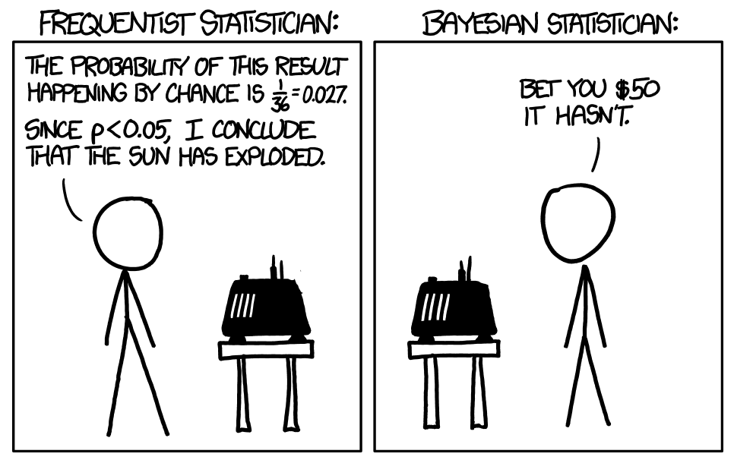
Probability - The mathematical possibility and/or likelihood of event happening
Probability can be broken down in separate approaches
Frequentist Statistics
This approach is more precise and statistical based on Hard Data
Bayesian Statistics
An approach is more experimental based on critical thinking mixed with Hard Data

Slide 4
Probability - The mathematical possibility and/or likelihood of event happening
Probability can be broken down in separate approaches
Frequentist Statistics
This approach is more precise and statistical based on Hard Data
Calculates probability or an event in the long run of an experiment
This approach is more precise and statistical
Moreso based on hard data
Calculates P(Data/Hypothesis)
Based Overwhelmingly on Data
Mostly used with All of the Data needed
Sampling Distribution
Hypothetical Experiments
Considered a more traditional method

Slide 5
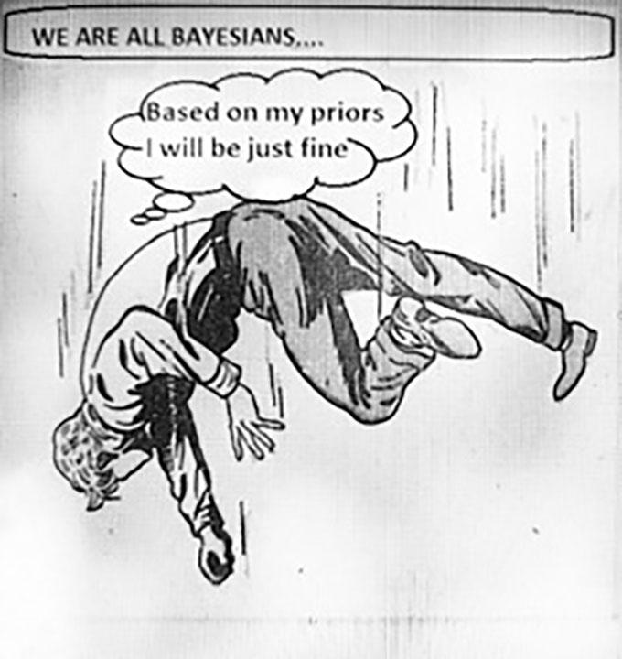
Probability - The mathematical possibility and/or likelihood of event happening
Frequentist Statistics
This method is based on believing a test is always the answer
Ex. Jumping 100 feet from a building will certainly break your legs
We want to test this instead of using the prior knowledge of people breaking their legs

Slide 6
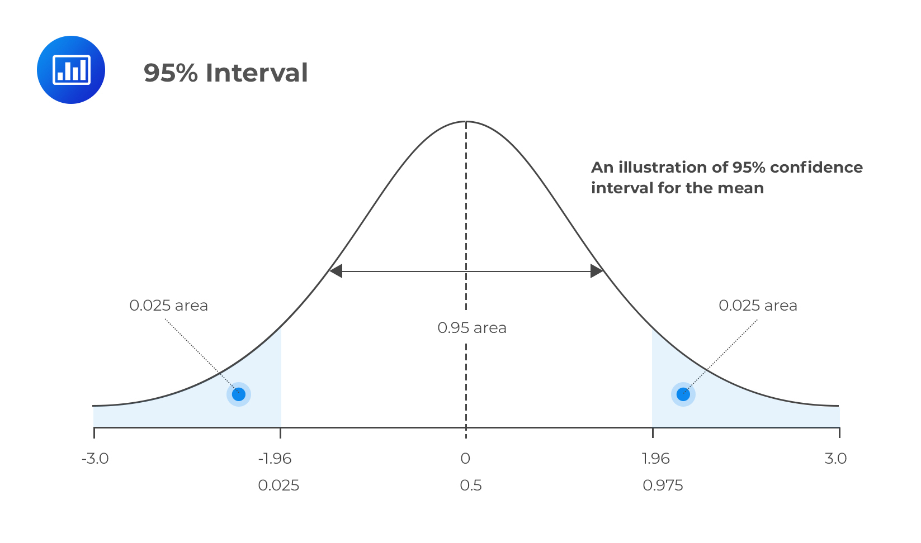
Probability - The mathematical possibility and/or likelihood of event happening
Frequentist Statistics
Utilize Confidence interval
Means that with a large number of repeated samples, 95% of such calculated confidence intervals would include the true value of the parameter.

Slide 7

Probability - The mathematical possibility and/or likelihood of event happening
Frequentist Statistics
Utilize Confidence interval
Means that with a large number of repeated samples, 95% of such calculated confidence intervals would include the true value of the parameter.

Slide 8
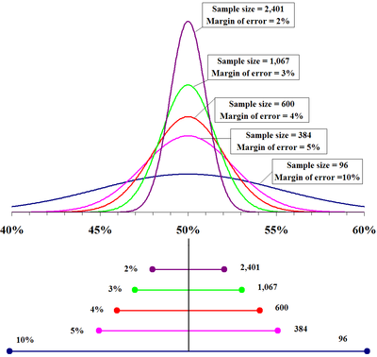
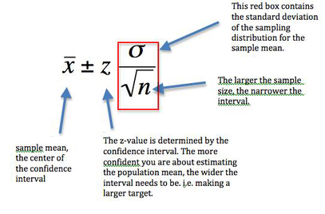
Probability - The mathematical possibility and/or likelihood of event happening
Frequentist Statistics
Utilize Margin of Error
This tells us the larger the margin of error, the less confidence the Data Scientist has that the sample reflects the population.

Slide 9
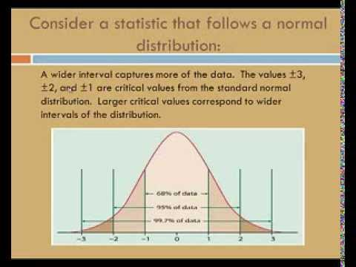
Probability - The mathematical possibility and/or likelihood of event happening
Frequentist Statistics
Utilize Margin of Error
This tells us the larger the margin of error, the less confidence the Data Scientist has that the sample reflects the population.

Slide 10
Probability - The mathematical possibility and/or likelihood of event happening
Bayesian Statistics
They believe in testing with a combination of prior knowledge

Slide 11
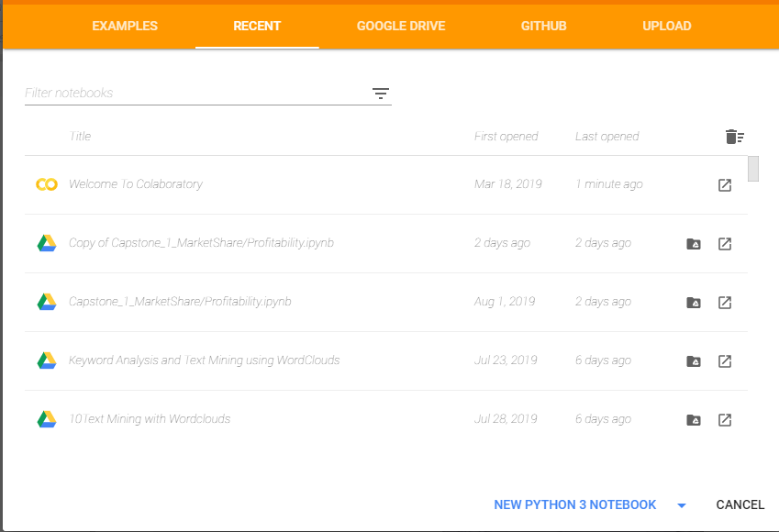
Go to Website and Create New Python Notebook
https://colab.research.google.com/

Slide 12
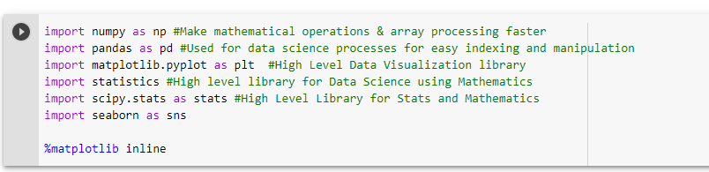

Slide 13
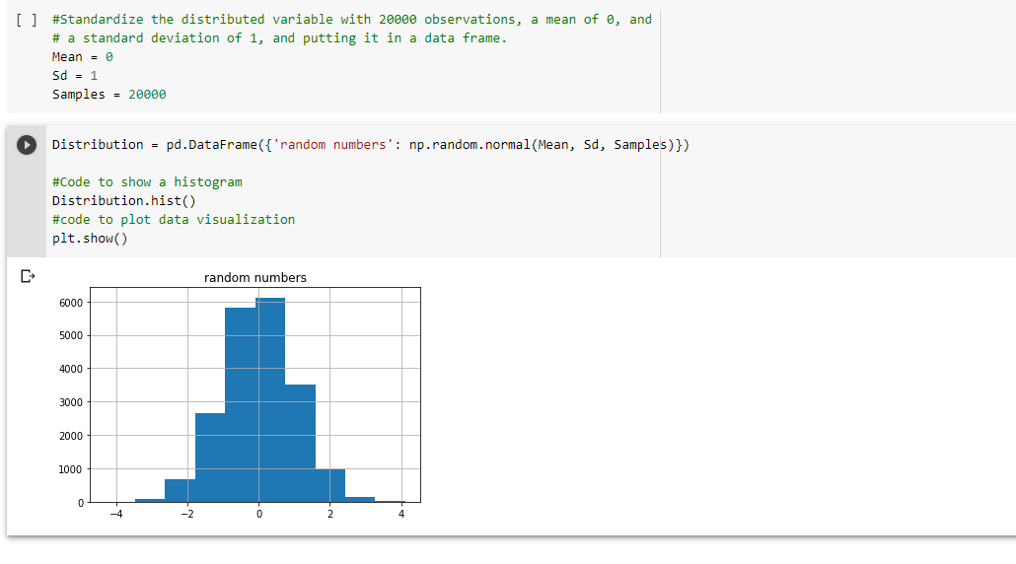

Slide 14
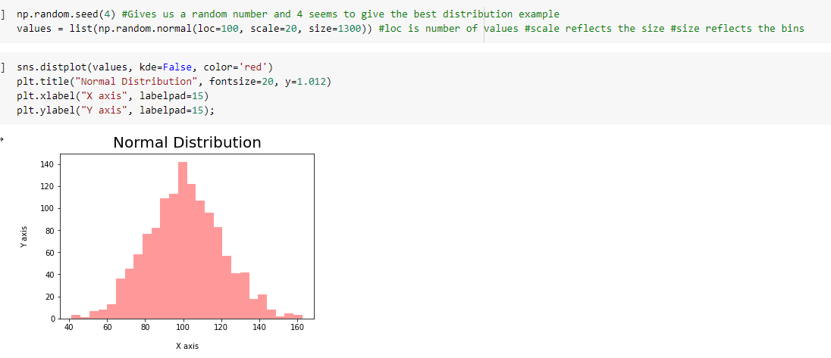

Slide 15
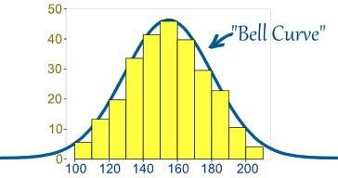
What is Normal Distribution?
Data that is Normally Distributed
This tell us most values are near the mean
When data is normally distributed this means the Mean and Median are equal
Median is simply the middle number
1,2,3,4,5 (Median is 3)
1,2,3,4,5,6 (Median is 3+4 divided by 2 = 3.5)
When data is not normally distributed that means a bias to the left or right exists
Represented by a Standard Bell Curve’
The yellow marks represent bins
Bins are called “Bin Widths”

Slide 16
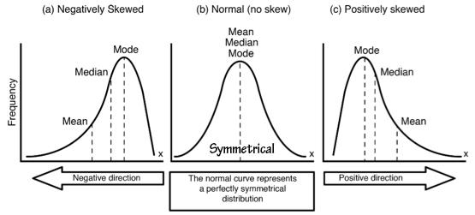
Different Types of Distribution

Slide 17
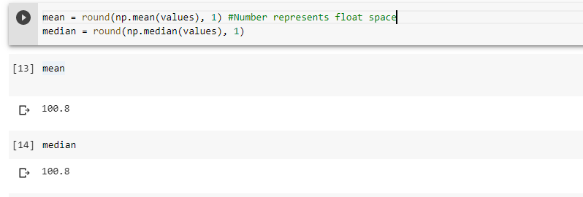
Different Types of Distribution

Slide 18
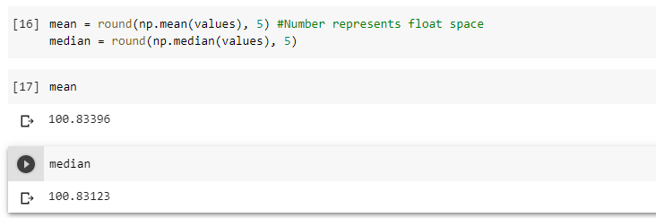
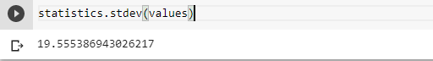
Different Types of Distribution

Slide 19
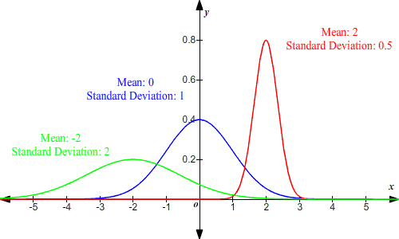
Normal Distribution Use Cases
These are what different distributions look like when the Means and Standard Deviations are higher and lower

Slide 20
What is Asymmetrical Distribution?
A positive skewed, right skewed or Asymmetrical distribution is a type of distribution in which more values are concentrated on the left side or tail of the distribution

Slide 21
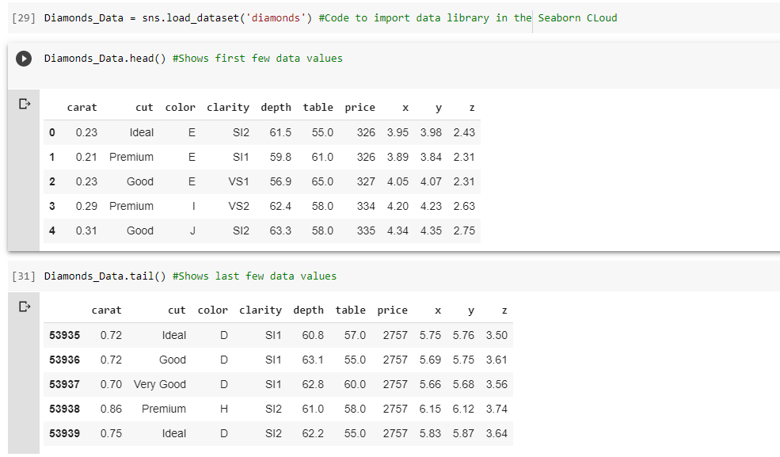

Slide 22
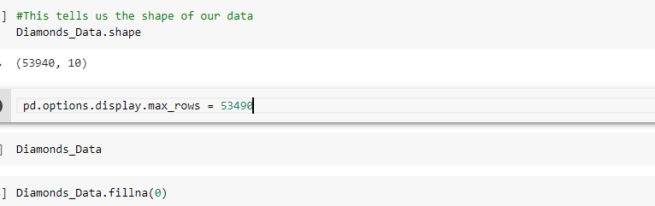

Slide 23
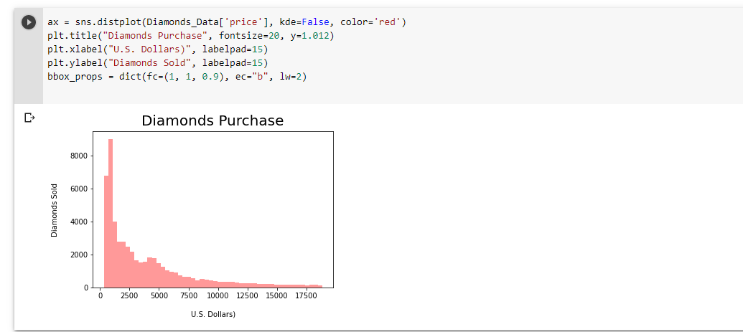

Slide 24
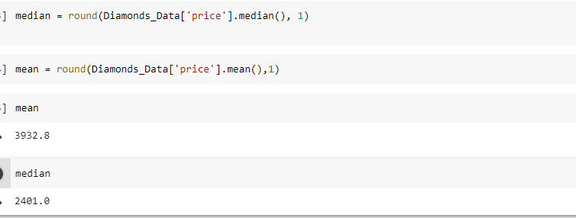

Slide 25
What is Asymmetrical Distribution?
A negative skewed, left skewed or Asymmetrical distribution is a type of distribution in which more values are concentrated on the right side or tail of the distribution

Slide 26
What is Asymmetrical Distribution?
This occurs typically when the mean is less than the Median (even if by a few floats)
Example: Mean 12.35 Median 12.89
A negative skewed, left skewed or Asymmetrical distribution is a type of distribution in which more values are concentrated on the right side or tail of the distribution

Slide 27
https://mathbitsnotebook.com/Algebra2/Statistics/STzScores.html
https://dfrieds.com/math/skewness.html
https://towardsai.net/p/data-science/how-when-and-why-should-you-normalize-standardize-rescale-your-data-3f083def38ff
https://towardsdatascience.com/catboost-vs-light-gbm-vs-xgboost-5f93620723db

